Slide 1
Light grading Boosting Algorithm

Slide 2
Light GBM:
Light GBM, short for light gradient-boosting machine, is a free and open-source distributed gradient-boosting framework for machine learning.
It is based on decision tree algorithms and used for ranking, classification and other machine learning tasks. The development focus is on performance and scalability.

Slide 3
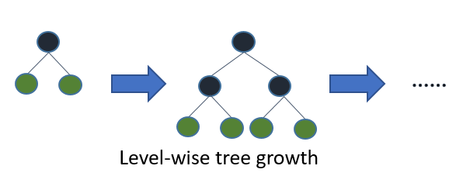
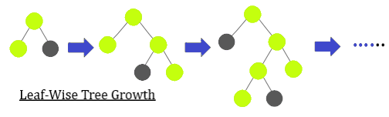
Other Algorithm Grow in Level wise
Light GBM Algorithm Grow in Leaf Wise

Slide 4
Key Points:
The LightGBM framework supports different algorithms including GBT, GBDT, GBRT, GBM, MART and RF.
LightGBM has many of XGBoost's advantages, including sparse optimization, parallel training, multiple loss functions, regularization, bagging, and early stopping.

Slide 5
LightGBM does not use the widely used sorted-based decision tree learning algorithm.
LightGBM implements a highly optimized histogram-based decision tree learning algorithm, which yields great advantages on both efficiency and memory consumption.
The LightGBM algorithm utilizes two novel techniques called Gradient-Based One-Side Sampling (GOSS) and Exclusive Feature Bundling (EFB)

